Slide 1

Al based diabetes prediction system

Slide 2

Name: k.valarmathi
Branch: biomedical engineering
Project Name: AI based diabetes prediction system
Course Name: Artificial intelligence

Slide 3

Artificial intelligence (AI) can make advanced inferences based on a large amount of data. The mainstream technologies of the AI boom in 2021 are machine learning (ML) and deep learning, which have made significant progress due to the increase in computational resources accompanied by the dramatic improvement in computer performance. In this review, we introduce AI/ML-based medical devices and prediction models regarding diabetes.
Abstract:-

Slide 4
AI use in current diabetes management
Next, we discuss the use of AI in medicine for diabetes, specifically in medical devices. The first AI-based medical device, BodyGuardian, was cleared by the US Food and Drug Administration (FDA) in 2012 when approval was given to a patch-like electrocardiogram equipped with an AI-based arrhythmia detection algorithm. Since then, the regulations on programmed medical devices, including AI, have advanced in various countries, including the USA, Europe, China, and Japan. Thanks to the outstanding development of deep learning technology and advancements in clinical applications these days, the number of approved AI-based medical devices has dramatically increased in both the USA and Europe in the past few years

Slide 5
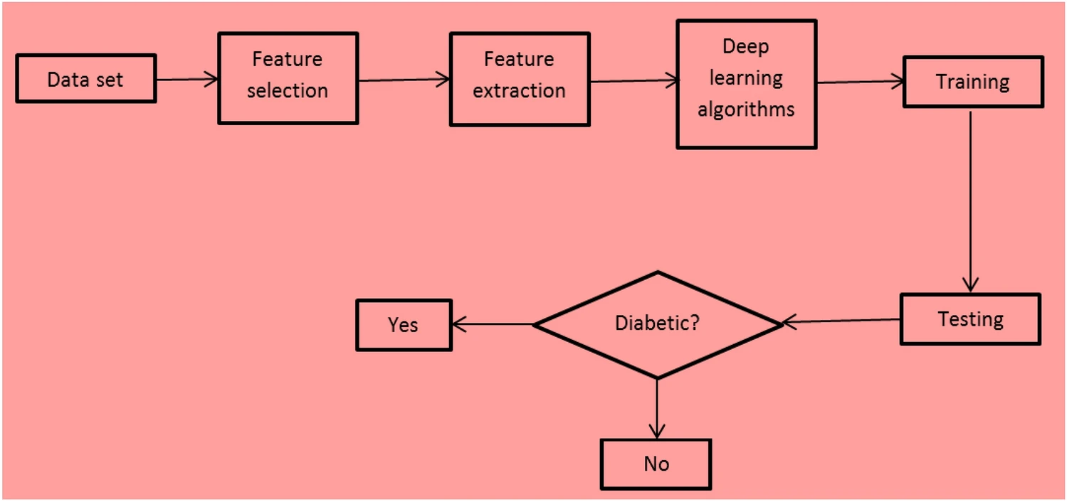

Slide 6
Challenges
Loss of eyesight: in 2010 Diabetic retinopathy caused 2.6% of blindness globally and 1.9% of moderate or severe visual loss. Studies show the diabetic patient prevalence of any retinopathy is 35%, but vision-threatening is 7%. People suffering from type 1 diabetes retinopathy rates are higher among them.

Slide 7
Renal disease: Information [29] received from different sources describes that diabetes is the main cause of 80% cases of kidney-related disease (ESRD). The ratio of kidney problems because of diabetes is 15–55%. Renal disease very much dependent on renal replacement therapy and access to dialysis and—(and in some cases within) in different countries these are highly variable.

Registration
Coaching
Acceptance
Coaching

Slide 8
Import libraries
import numpy as np
import pandas as pd
import matplotlib.pyplot as plt
import seaborn as sns
sns.set()
from mlxtend.plotting import plot_decision_regions
import missingno as msno
from pandas.plotting import scatter_matrix
from sklearn.preprocessing import StandardScaler
from sklearn.model_selection import train_test_split
from sklearn.neighbors import KNeighborsClassifier
from sklearn.metrics import confusion_matrix
from sklearn import metrics
from sklearn.metrics import classification_report
import warnings
warnings.filterwarnings('ignore')
%matplotlib inline

Slide 9
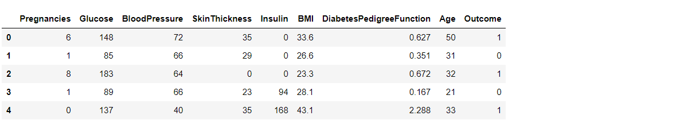
Output
Here we will be reading the dataset which is in the CSV format
diabetes_df = pd.read_csv('diabetes.csv')
diabetes_df.head()

Slide 10
AI aims to make accurate and advanced predictions for a large amount of knowledge data. As of 2021, AI most often refers to machine learning and deep learning, which have made significant progress with increased computational resources due to a dramatic improvement in computer performance. In diabetes diagnosis and treatment, AI-based medical devices have already been approved by the FDA and are available in other countries as well. Currently, many studies have used machine learning to predict the onset of diabetes. However, these machine learning approaches have not demonstrated superior performance in predicting disease onset compared to conventional statistical techniques that combine risk factors. Nevertheless, we believe that continuous research in machine learning and efforts toward its practical application will maximize the predictive performance of AI—using large amounts of organized data and abundant computational resources—and dramatically improve the predictive accuracy of disease diagnosis, prevention, and treatment in diabetes.
Conclusion

Slide 11
THANK YOU

